Slide 1

Microsoft movie studio Data analysis and Findings

Slide 2
Business understanding and data preparation
Microsoft wants to venture into creating original video content, their strategic plan includes creating a new movie studio. Before delving into the market, Microsoft wants to explore what types of films are currently doing the best at the box office. For this project, I will use exploratory data analysis to generate insights for Microsoft. Three data sets were used in this business problem.
Interesting findings emerged during the analysis that can help Microsoft set up the studio. I was able to find the best-performing studio by domestic and foreign gross, the best-performing genres and market trends across the years.
The data was well-suited for Microsoft. However, the data had several missing values which is a big limitation. Secondly, there were a few columns (tconst and 3 movie tiles (Primary_title, original_title and title) which were not important in our analysis. We were able to remove all missing values in the data set and conduct data cleaning.

Slide 3
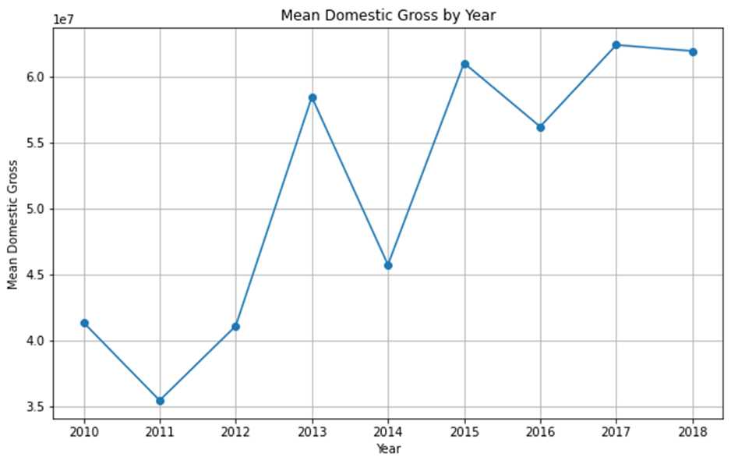
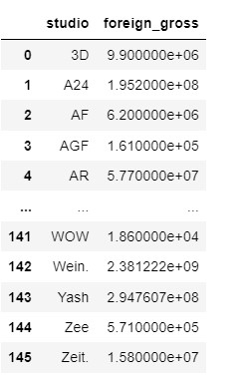
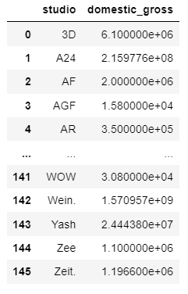
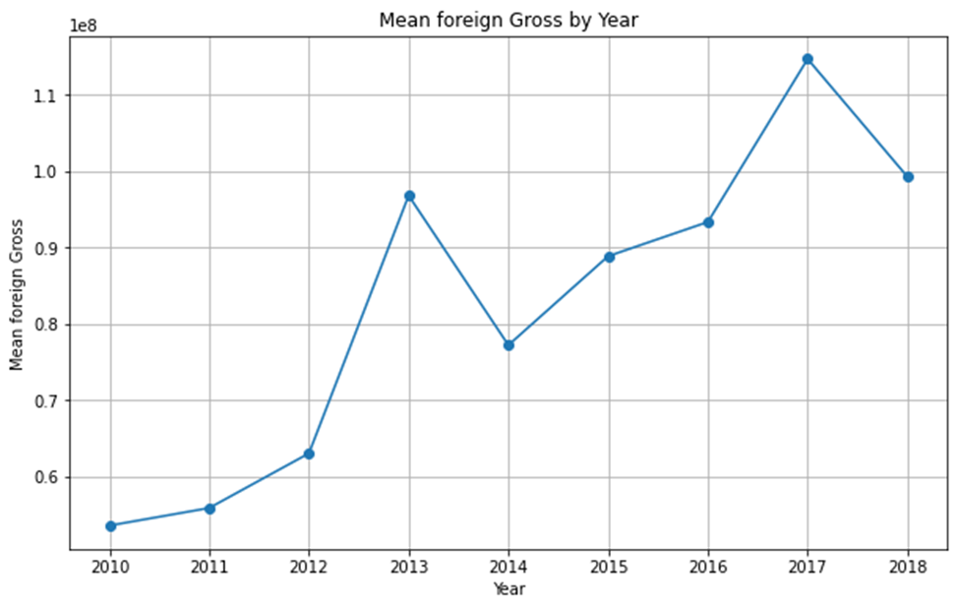
3D studio has the highest domestic and foreign gross in comparison to all the other Studios.
The domestic gross increased since 2010, and there was a sharp increase in the domestic gross between 2011 and 2013.
The foreign gross increased between 2010 and 2013. The foreign gross decreased between 2013 and 2014, then increased till 2017.

Slide 4
Conclusion
Focus on the top genres
Monitor Domestic Gross and foreign gross Trends
Since Drama is the most watched genre followed by Comedy-Drama, Adventure-Animation-Comedy, and Comedy-Drama-Romance, Miscrosoft should prioritize creating movies around these genres. Understanding audience preferences in these genres can help tailor movies to maximize viewership.
There was a sharp increase in domestic gross between 2011 and 2013. The domestic gross then increased from 2014 which suggests fluctuations in the market. Studios should closely monitor these trends and identify factors contributing to fluctuations. There was an increase in foreign gross between 2010 and 2013, followed by fluctuations. Microsoft should understand other countries' political, economic, social, technological, legal and environmental factors as these factors affect the viewership of movies. For example, are certain movies banned in certain countries, and does the population of country B have access to internet?
Quality of the movies
The observation that movie ratings increased between 2010 and 2013, followed by a decline, significantly highlights the importance of quality and understanding the needs of the viewers. Studios should prioritize producing high-quality content that resonates with the audience. Additionally, analyzing factors that have contributed to low ratings is important for improvement.
Benchmarking
3D Studio had the highest domestic and foreign gross in comparison to the other studios. Microsoft can use its movie studio data to assess the kind of movies mostly produced as a benchmark of creating its own movie studio.

Slide 5



Business model and next steps
Research
Abstract
Design
The dataset showed that there was a great change in domestic and foreign gross and average rating between 2013 and 2014. Microsoft team needs to conduct further market research to nuance the causes of the changes in the market. This will help them understand the causes of market changes to be able to prepare for future shocks.
Microsoft should continuously conduct market analysis and trends, to understand the needs of its audience.
Now that Miscrosoft understand knows its competitor, it should develop its new movies studi design with an compertitive edge to bead 3D.

